Slide 1
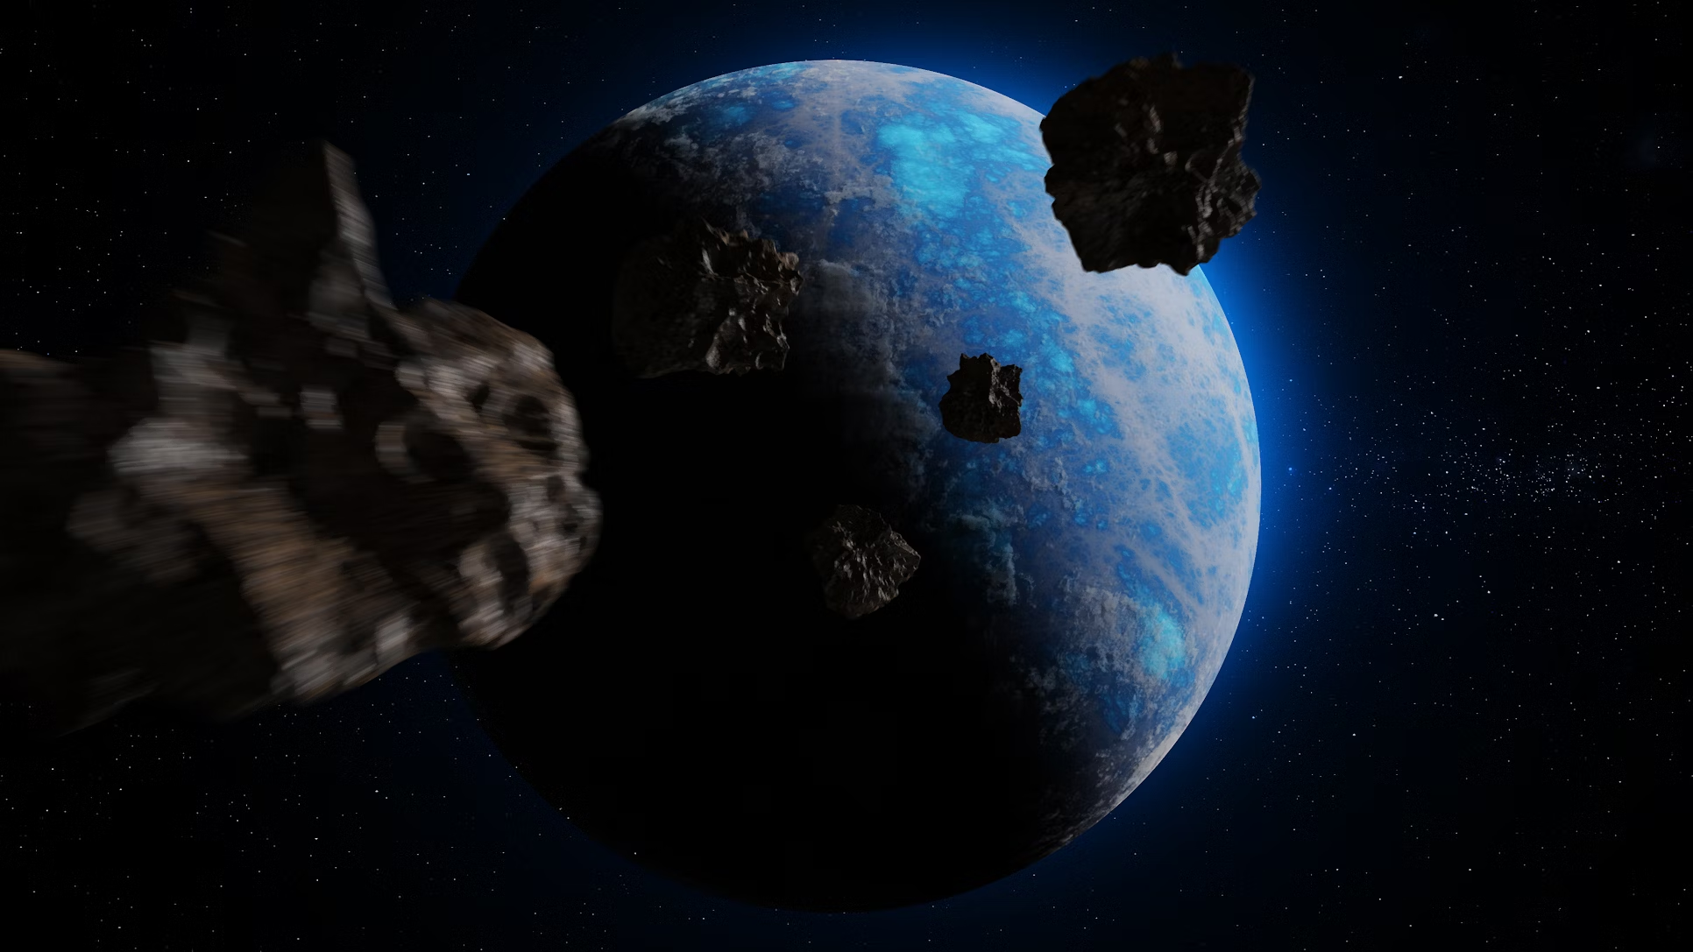
Classifying
Potentially
Hazardous
Near-Earth
Objects
Data Science Programming
August 12, 2024
Aileen Li, Eshaan Arora, Felipe Zapater, Gayathree Gopi, Jose Currea
Notes:
Eshaan

Slide 2
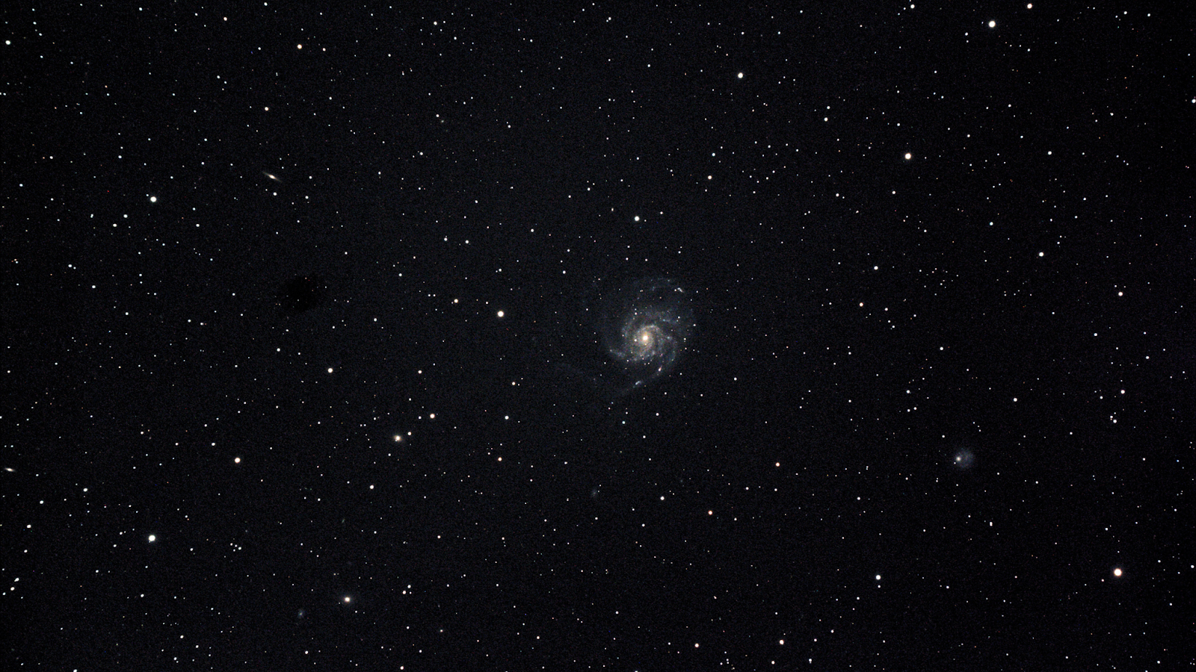
TABLE OF CONTENTS
01
02
03
04
OVERVIEW
EDA
MODELS
IMPLICATIONS
Notes:
Eshaan

Slide 3

01
OVERVIEW
Notes:
Eshaan

Slide 4
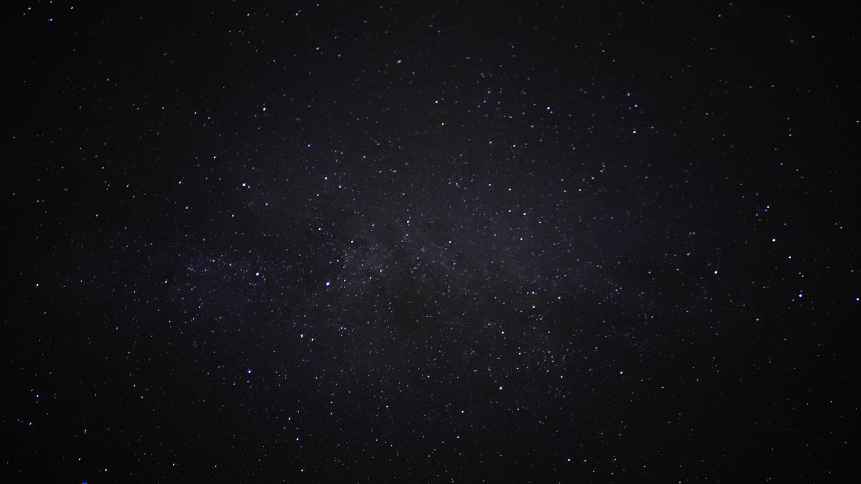
Introduction
Problem statement:
Earth had more than 100 close encounters with asteroids in 2022
Need models to identify hazardous objects to prepare for potential collisions
Goal: Test and refine classification models using NASA data on near-earth objects from 1910-2024 in order to successfully identify whether an NEO is hazardous
Notes:
Eshaan

Slide 5
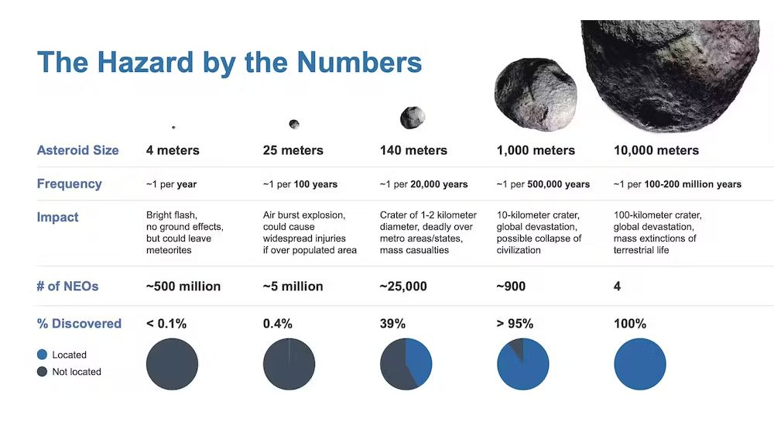
Notes:
Eshaan
From a 2023 article in Space.com

Slide 6
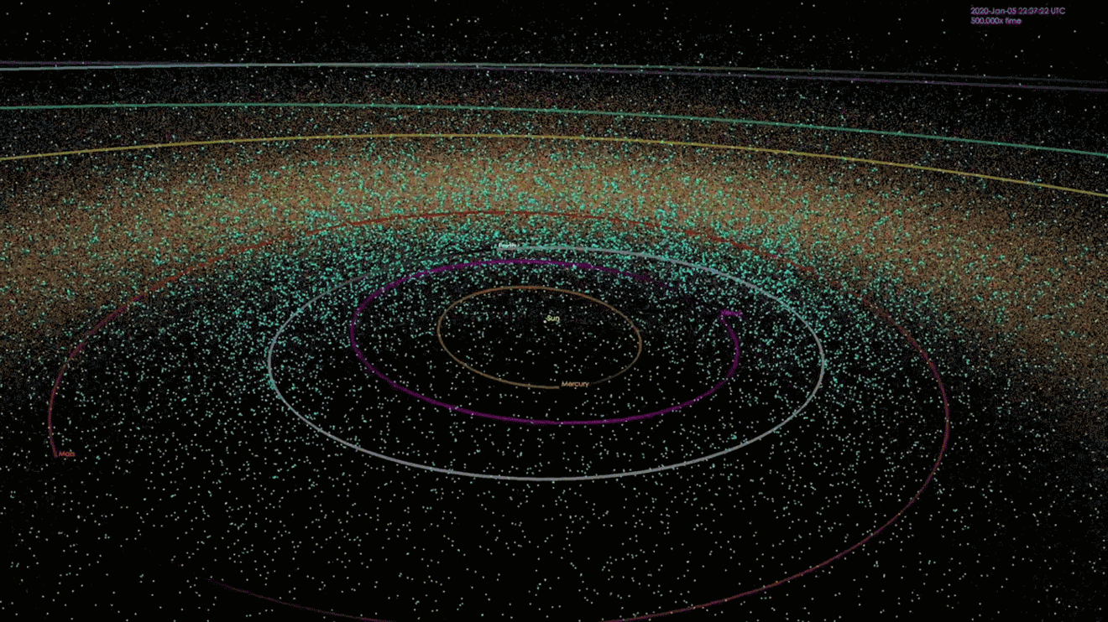
Notes:
Eshaan
From an article published by the Jet Propulsion Laboratory at Caltech: The animation depicts a mapping of the positions of known near-Earth objects (NEOs) at points in time over the past 20 years, and finishes with a map of all known asteroids as of January 2018. Asteroid search teams supported by NASA's NEO Observations Program have found over 95 percent of near-Earth asteroids currently known. There are now over 18,000 known NEOs and the discovery rate averages about 40 per week.

Slide 7
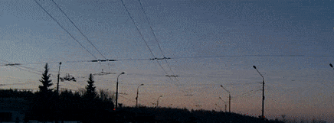
Chelyabinsk meteor
February 15, 2013
Notes:
Eshaan
The Chelyabinsk meteor, 2013

Slide 8
About the Data
NASA data from 1910-2024 on near-earth objects and their properties
338,199 observations
Variables: neo_id (unique identifier for each asteroid), name (given by NASA), absolute_magnitude (intrinsic luminosity), estimated_diameter_min and max (in km), orbiting_body (planet the asteroid orbits), relative_velocity (to Earth in kmph), miss_distance (in km), is_hazardous (True or False)
Notes:
Eshaan

Slide 9

02
EDA
Notes:
Aileen

Slide 10
WRANGLING / FE
Dropped missing values & orbiting_body variable (one unique value)
One-hot encoded is_hazard
Created new estim_diameter features and dropped old ones
Normalized features
Downsampled 10% of data for visualizations
Notes:
Aileen

Slide 11
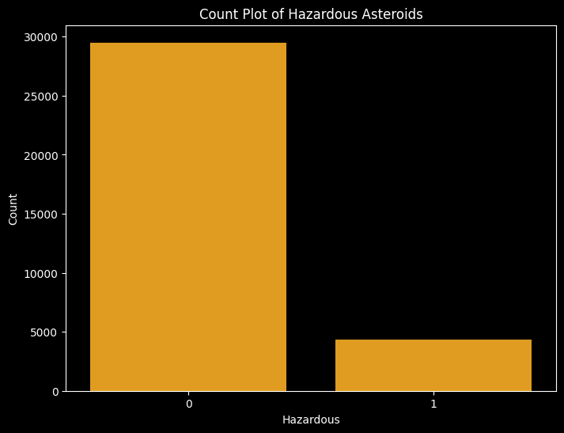
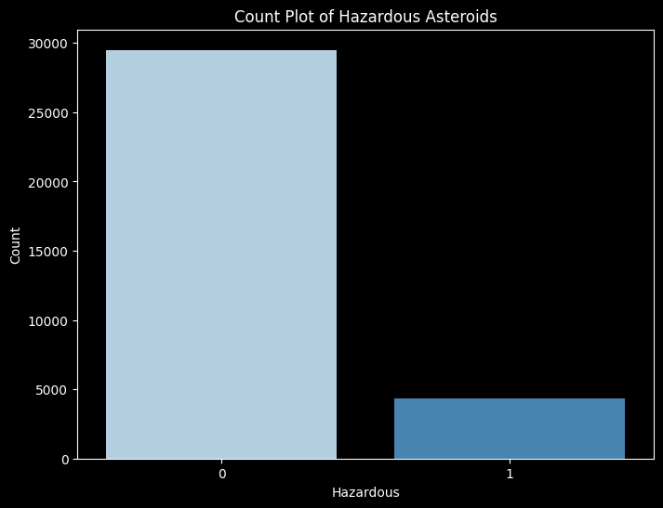
Notes:
Aileen
87% false 13% true cases. Imbalance. Correct using cross-validation

Slide 12
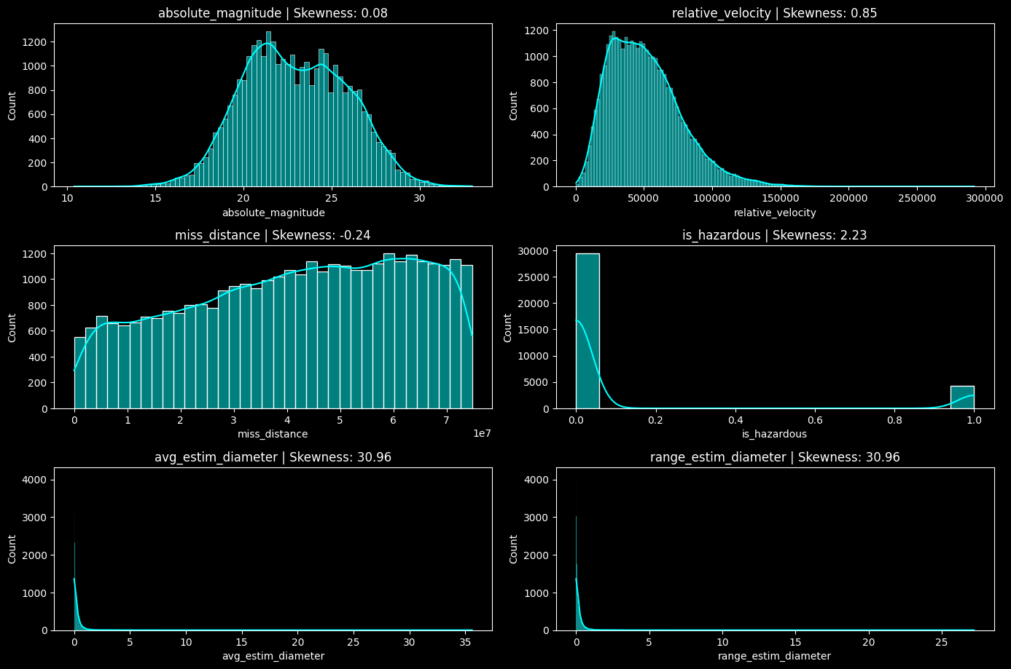
Notes:
Aileen
Abs magnitude balanced bimodal. Avg estim dia, range estim dia and rel vel right skewed meaning more smaller asteroids with lower velocities but some larger asteroids with higher velocities (mean>median).
Left skew = mean<median, more asteroids with lower miss distance but central tendency of asteroids is higher

Slide 13
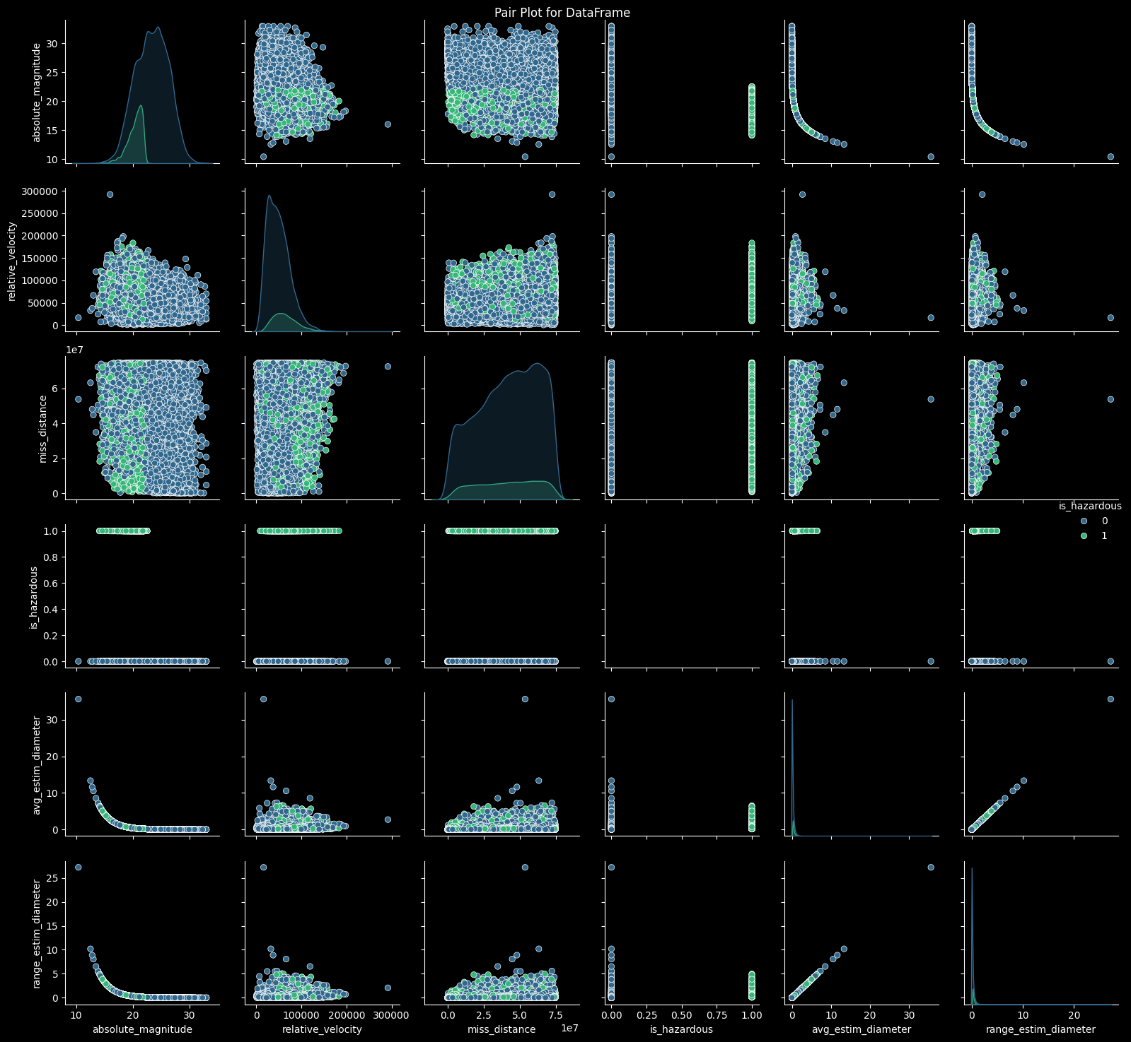
Notes:
Aileen

Slide 14
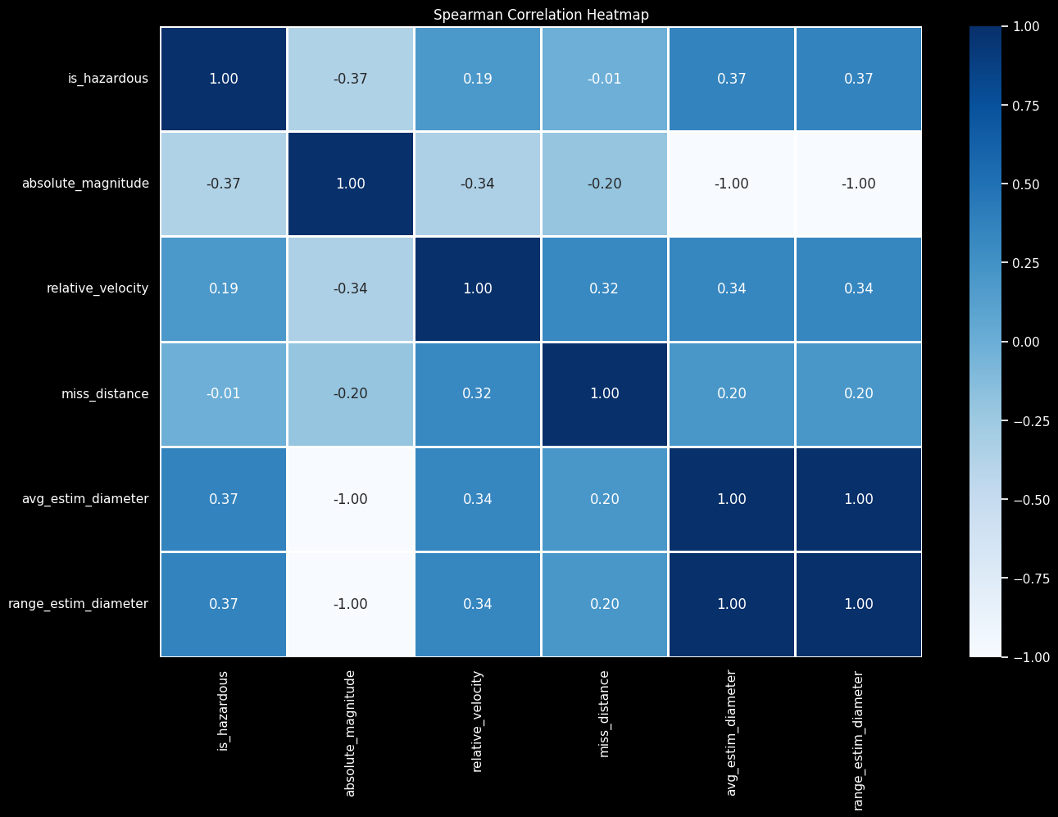
Notes:
Aileen

Slide 15
EDA Insights
Skewness suggests a few large, fast asteroids
Separation between hazardous and non-hazardous asteroids especially by magnitude
Positive correlations between asteroid size and hazard status
Miss distance shows little correlation with hazard status
Notes:
Aileen
### Slide Title: **Asteroid Data Analysis: Key Findings**
- **Skewed Distributions**: Significant right skewness in relative velocity, average, and range diameters, suggesting a few large, fast asteroids.
- **Predictor-Response Insights**: Scatter plots reveal separation between hazardous and non-hazardous asteroids, especially by magnitude and diameter.
- **Correlation Highlights**: Moderate positive correlations between asteroid size and hazard status, with larger asteroids being more hazardous.
- **Minimal Impact of Proximity**: Miss distance shows almost no correlation with hazard status, indicating proximity isn't a key hazard factor.

Slide 16
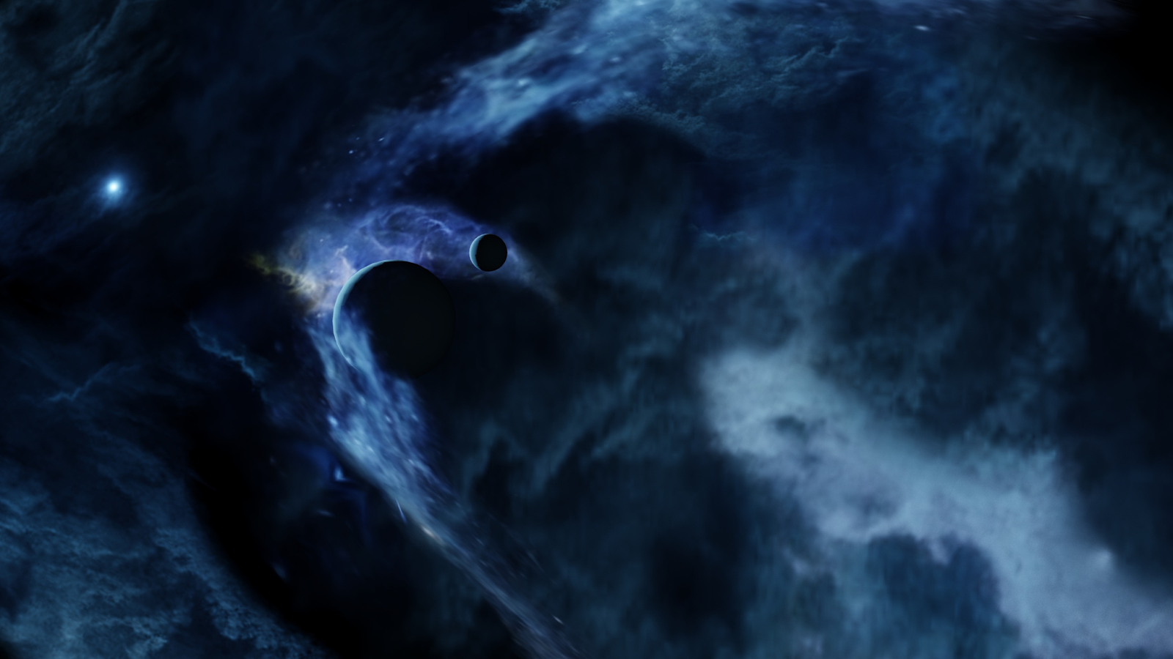
03
MODELING
Notes:
Gayathree

Slide 17
k-Nearest Neighbors
Accuracies before CV:
Train: 0.897
Test: 0.882
Accuracies after CV:
Train: 0.896
Test: 0.883
Confusion Matrix:
Predicted Values
+ -
+ 86104 2374
- 9533 3432
Actual
Values
Notes:
Gayathree
Tested k-Nearest Neighbors classifier with 17 neighbors uniform weights and Euclidean distance and performed 5-fold cross-validation
Model performed well, with accuracies of 0.897 and 0.882 before CV and accuracies of 0.896 and 0.883 after CV
Low possibility of overfitting due to the small differences in train and test accuracies
But the low train accuracy in both cases indicates this model probably isn’t powerful or complex enough to capture the entire signal
Future: create/use new model parameters to see if that improves accuracy

Slide 18
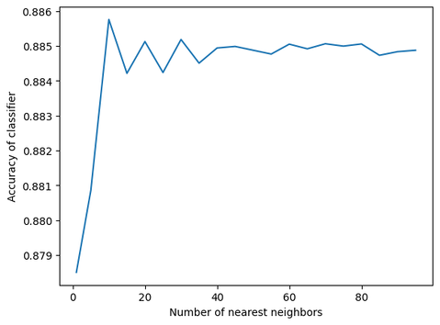
k-Nearest Neighbors
Optimal number
of neighbors: 15-17
Notes:
Gayathree
Tested k-Nearest Neighbors classifier with 17 neighbors uniform weights and Euclidean distance and performed 5-fold cross-validation
Model performed well with accuracies of 0.897 and 0.882 before CV and accuracies of 0.896 and 0.883 after CV
Low possibility of overfitting due to the small differences in train and test accuracies
Got that the optimal number of nearest neighbors was 15-17
But the low train accuracy in both cases indicates this model probably isn’t powerful or complex enough to capture the entire signal
Future: create/use new model parameters to see if that improves accuracy

Slide 19
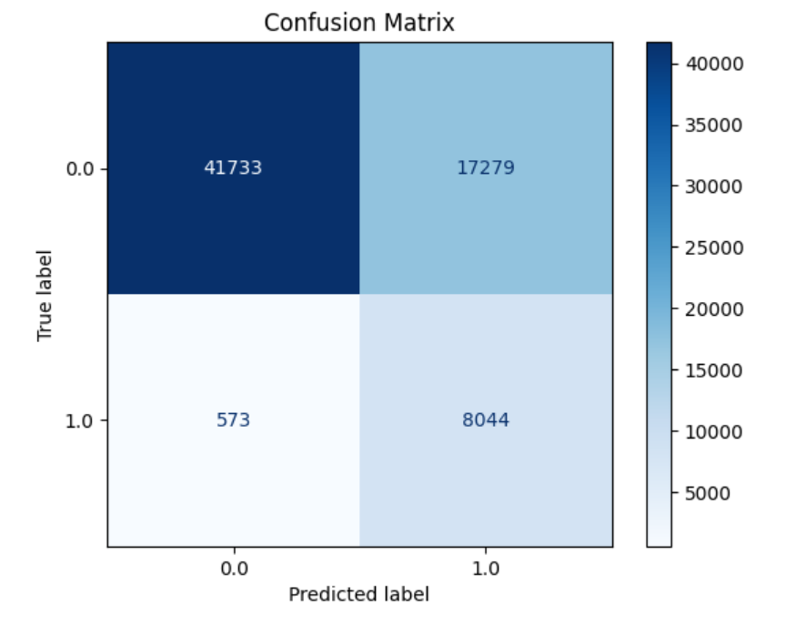
Naïve Bayes
Data Preprocessing/Model Fitting
Numeric features binned
Dummy variables
Model trained and fitted
Model Results/Accuracy
Train Accuracy: 0.7345
Test Accuracy: 0.7360
Notes:
Felipe

Slide 20
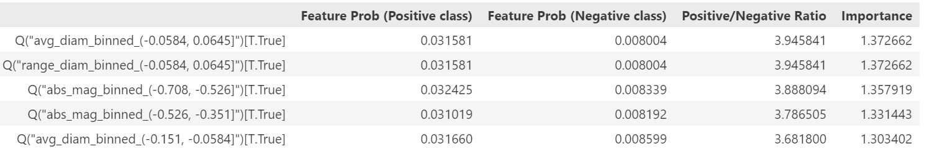
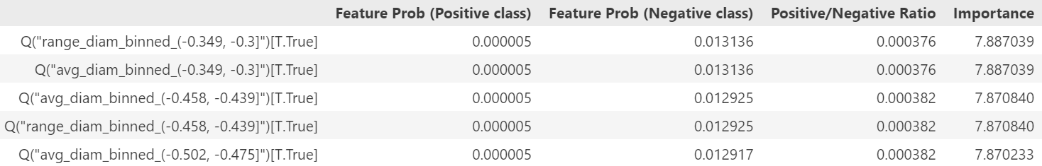
Naïve Bayes
Important Features for Determining NEO Hazardousness
Overall Feature Importance
Notes:
Felipe

Slide 21
Classification Tree
Confusion Matrix:
Predicted Values
+ -
+ 54960 4052
- 3907 4710
Accuracy:
0.882
Actual
Values
Classification Report:
Precision Recall f1-score support
0.0 0.93 0.93 0.93 59012
1.0 0.54 0.55 0.54 8617
Accuracy 0.88 67629
Macro avg 0.74 0.74 0.74 67629
Weighted avg 0.88 0.88 0.88 67629
Notes:
Eshaan
Accuracy:
0.882: This indicates that the model correctly predicted the class of the data points 88.2% of the time. It's a general measure of how often the model is correct.
Confusion Matrix:
This matrix helps you understand the types of errors the model is making. It has four key components:
True Positives (TP = 54,960): The number of positive class examples (labeled as +) that were correctly predicted.
False Positives (FP = 4,052): The number of negative class examples that were incorrectly predicted as positive.
False Negatives (FN = 3,907): The number of positive class examples that were incorrectly predicted as negative.
True Negatives (TN = 4,710): The number of negative class examples (labeled as -) that were correctly predicted.
Interpretation:
The model has a high overall accuracy (88.2%), but the performance on class 1.0 (minority class) is lower than on class 0.0. Specifically, the model has a lower precision (0.54) and recall (0.55) for class 1.0, indicating that it struggles more with predicting this class correctly.
The confusion matrix shows that there is a significant number of false positives (4,052) and false negatives (3,907), which suggests that the model might benefit from further tuning or using different approaches to handle class imbalance.

Slide 22
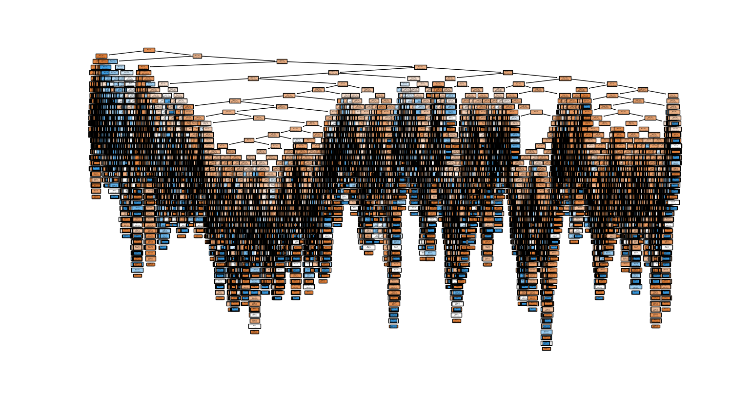
From this…
Notes:
Eshaan

Slide 23
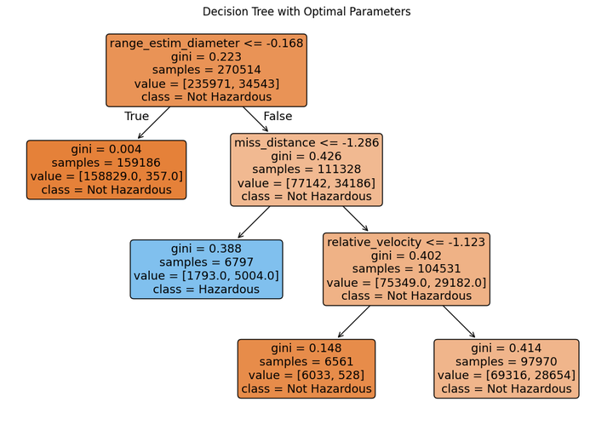
…to this
Notes:
Eshaan

Slide 24
Post-pruning
Best parameters found:
max_depth: 5 max_leaf_nodes: 4
min_samples_leaf: 1 min_samples_split: 2
Confusion Matrix:
Predicted Values
+ -
+ 58568 444
- 7389 1228
Actual
Values
Classification Report:
Precision Recall f1-score support
0.0 0.89 0.99 0.94 59012
1.0 0.73 0.14 0.24 8617
Accuracy 0.88 67629
Macro avg 0.81 0.57 0.59 67629
Weighted avg 0.87 0.88 0.85 67629
Notes:
Eshaan

Slide 25
Random Forest
Classification Report:
Precision Recall f1-score support
0.0 0.93 0.98 0.95 59012
1.0 0.73 0.14 0.24 8617
Accuracy 0.92 67629
Macro avg 0.85 0.75 0.79 67629
Weighted avg 0.91 0.92 0.91 67629
Confusion Matrix:
Predicted Values
+ -
+ 57582 1430
- 4016 4601
Actual
Values
Notes:
Nico

Slide 26
Random Forest (CV)
Classification Report:
Precision Recall f1-score support
0.0 0.92 0.98 0.95 59012
1.0 0.78 0.37 0.51 8617
Accuracy 0.91 67629
Macro avg 0.85 0.68 0.73 67629
Weighted avg 0.90 0.91 0.89 67629
Confusion Matrix:
Predicted Values
+ -
+ 58103 909
- 5389 3228
Actual
Values
Notes:
Nico

Slide 27
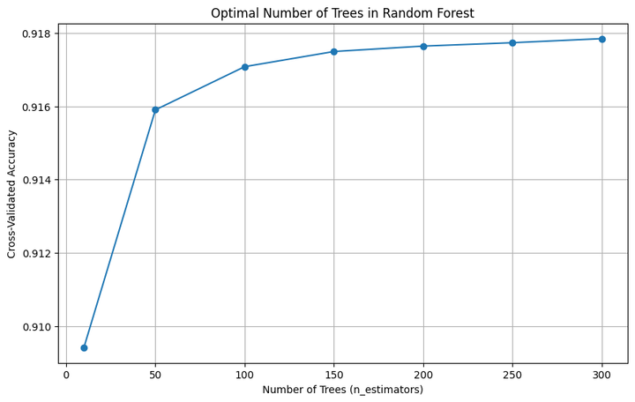
Random Forest
Notes:
Nico

Slide 28
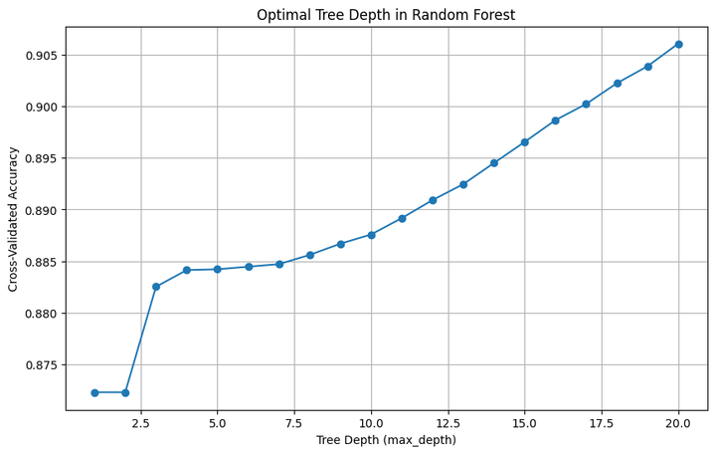
Random Forest
Notes:
Nico

Slide 29

04
IMPLICATIONS
Notes:
Felipe

Slide 30
Results
Best model:
Random forest: 91% accuracy
Worst model:
Naïve Bayes: 74% accuracy
Interesting findings:
Accuracy of random forest with default parameters was better than post cross-validation
Notes:
Felipe
Computational efficiency for cross-validating
Trying to do a grid search not feasible for 5 folds
Optimal number of trees and nodes also took a long time for CV
Best model was random forest

Slide 31
Implications
Risk Assessment and Prevention:
Informed decision making
Public Safety and Awareness
Efficient Resource Allocation:
Resources tracking hazardous NEOs
Scientific Advancements:
Better understanding of NEO characteristics
Model Limitations/Future Work:
Tuning parameters to reduce model error
Introduce new features (Physical characteristics of NEO)
Notes:
Felipe
Computational efficiency for cross-validating
Trying to do a grid search not feasible for 5 folds
Optimal number of trees and nodes also took a long time for CV
Best model was random forest

Slide 32

THANK YOU!
Questions?

Slide 33
Works Cited
Background and Images:
https://www.jpl.nasa.gov/news/twenty-years-of-tracking-near-earth-objects
https://www.space.com/asteroids-how-many-miss-earth-yearly
https://en.wikipedia.org/wiki/Chelyabinsk_meteor#/media/File:Meteorite_explosion_over_Chelyabinsk_on_February_15,_2013.gif
https://unsplash.com
Data set: https://www.kaggle.com/datasets/ivansher/nasa-nearest-earth-objects-1910-2024
Model Building Resources:
Professor Deepayan Chakrabarti, McCombs School of Business
ChatGPT

